Slide 2
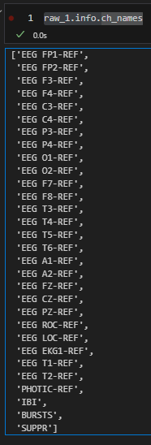
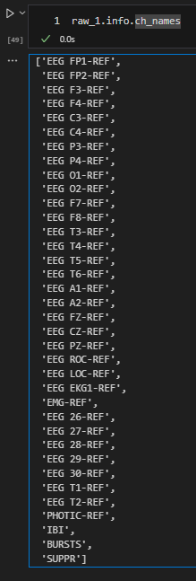
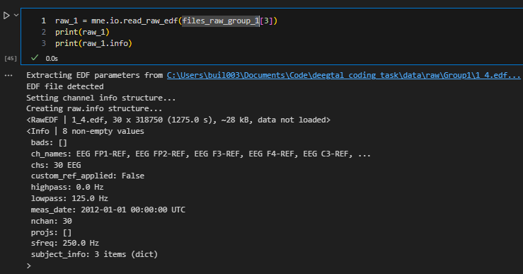
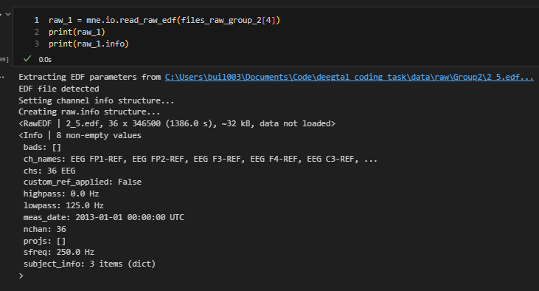
Data recorded equally?
No! nr of channels differs between subjects
Sampling freq + filtering = equal

Slide 3
Stats
Recording time: ~20-25min

Slide 4
Artifacts in EEG Signals and Preprocessing
The preprocessing step facilitates the removal of low-quality data without altering the clean data. This process also fragments the continuous raw signals without changing the data [45]. Artifact removal is an essential preprocessing step in the analysis of EEG signals, because the recordings usually include a significant number of extrinsic artifacts associated with environmental noise and experimental error, as well as intrinsic biological artifacts associated with body function (e.g., eye blinking, movement, respiration, and heartbeat) [46]. Various simple methods can be used to eliminate non-biological artifacts from EEG signals. Because environmental artifacts do not have the same frequency as the EEG signals of interest, they can be eliminated through application of a band filter [46]. Alternatively, standard operating procedures provide proper operational guidance for the data acquisition step and decreasing experimental artifacts [47]. However, the main types of biological noise include ocular artifacts, muscle artifacts, cardiac artifacts, and instrument artifacts, which require the use of filtering and/or computational methods to be removed from EEG data. More in-depth descriptions of these types of artifacts can be found in references [46,48]. According to the literature, extensive research has been conducted in the past decades [46,49] to identify and define efficient methods for both automatic and manual artifact removal.
https://pmc.ncbi.nlm.nih.gov/articles/PMC8615531/

Slide 5
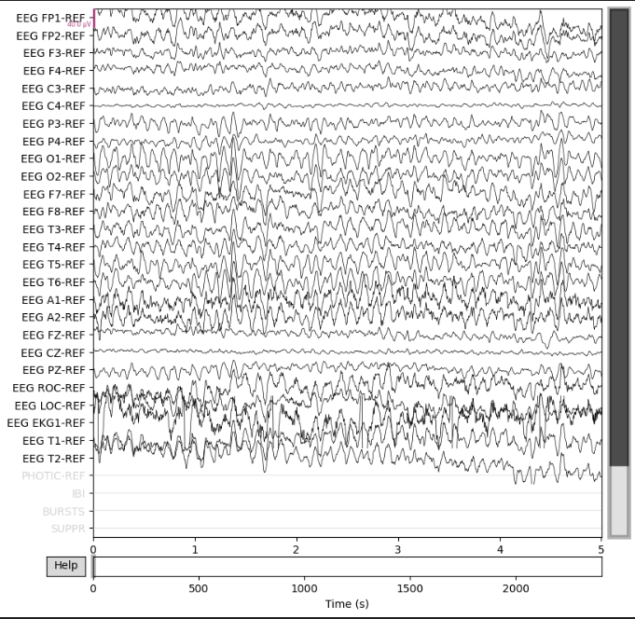
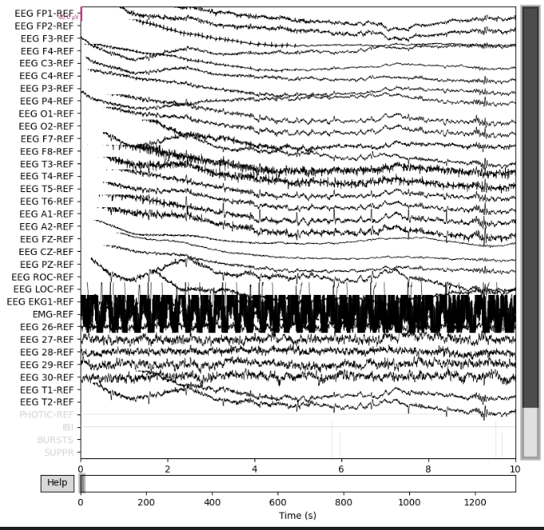
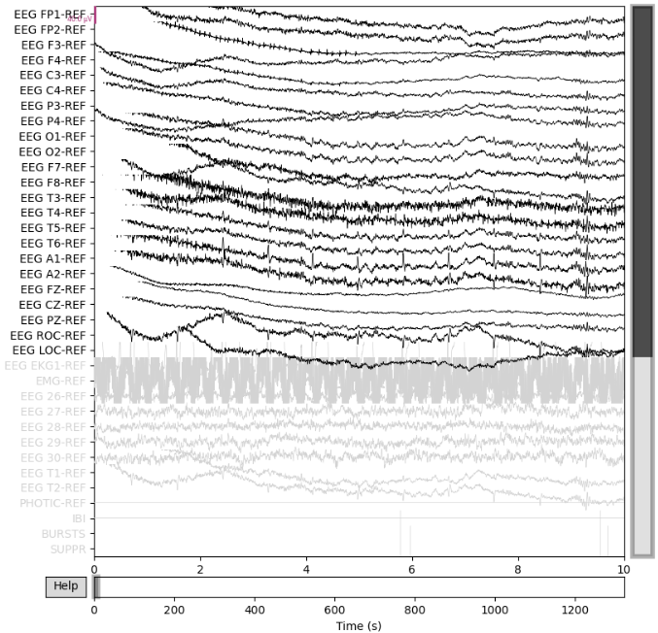

Slide 6
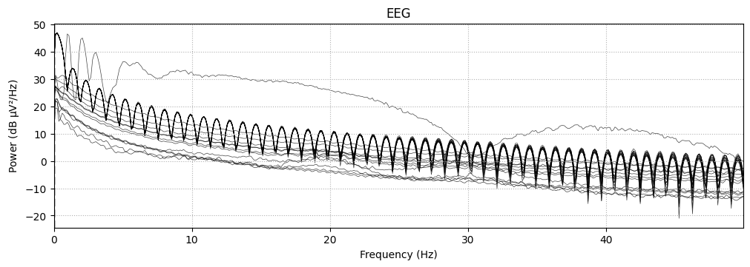
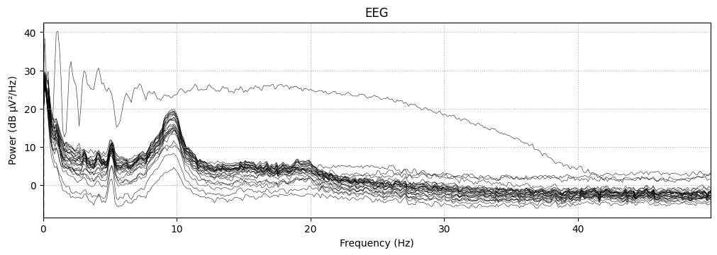
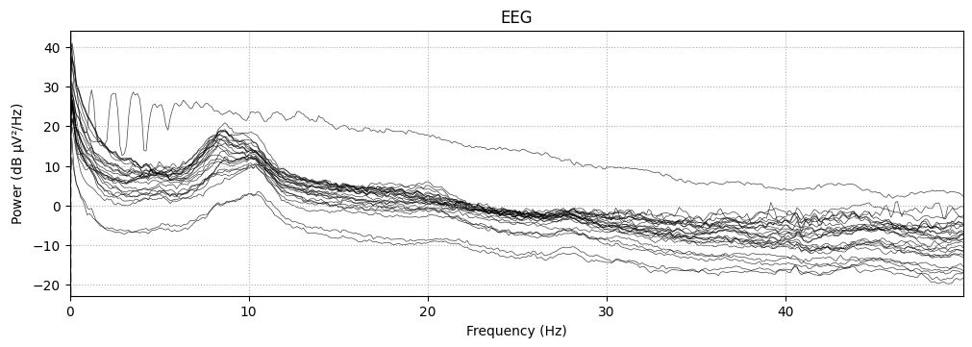
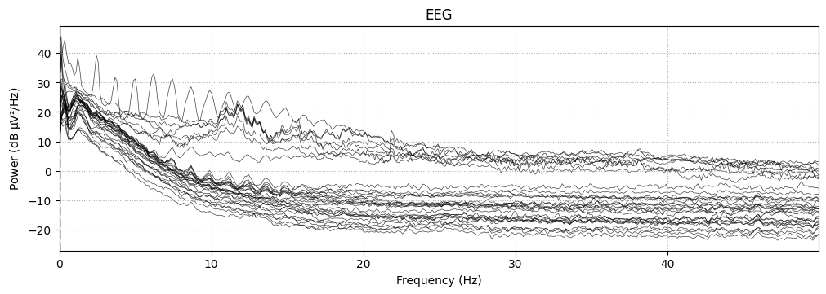
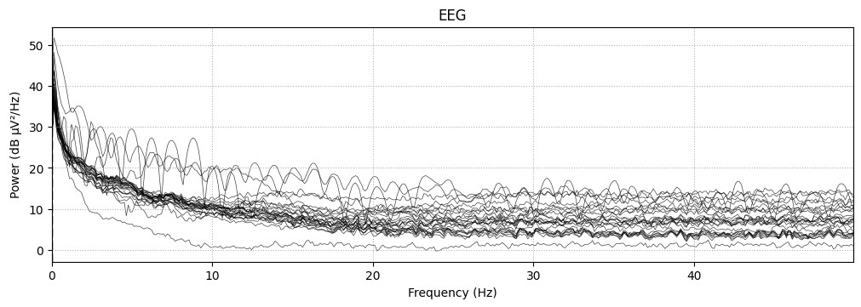
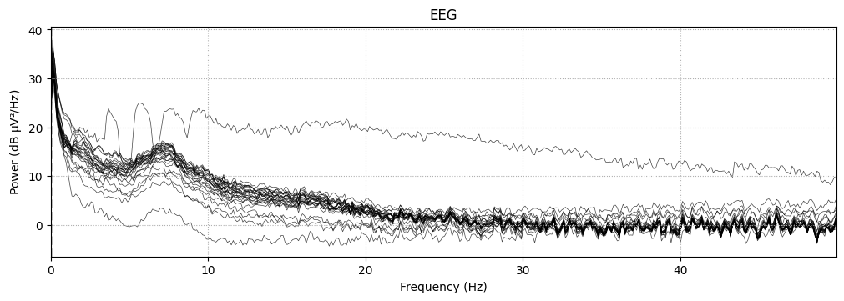
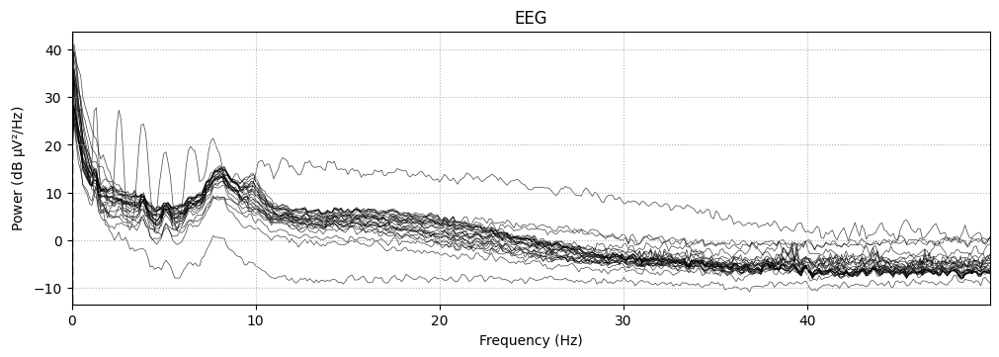
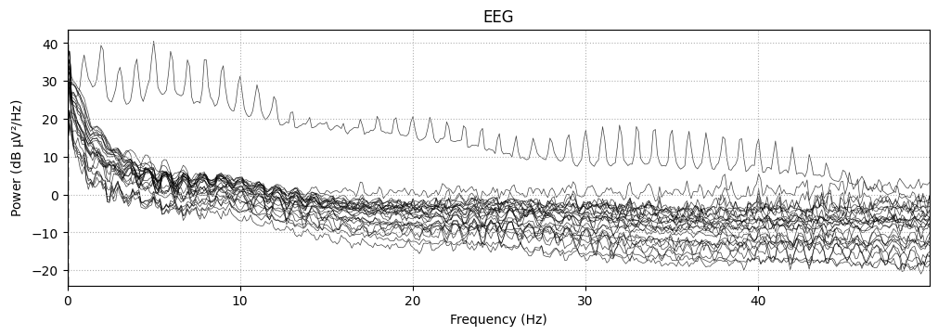
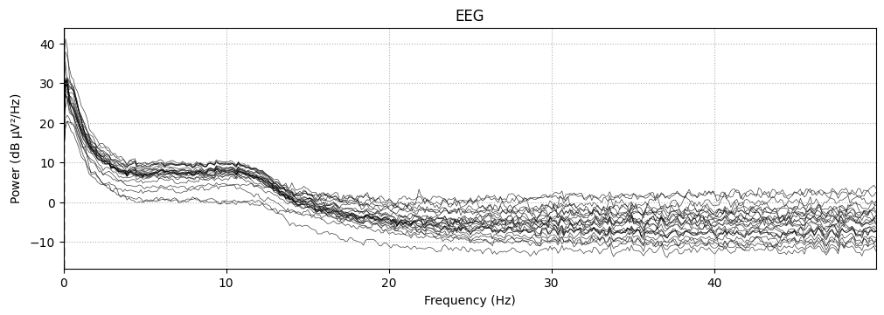
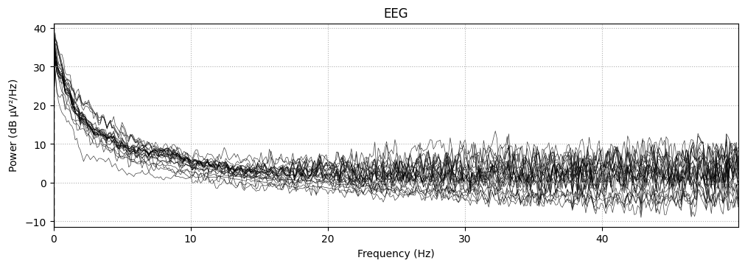

Slide 7
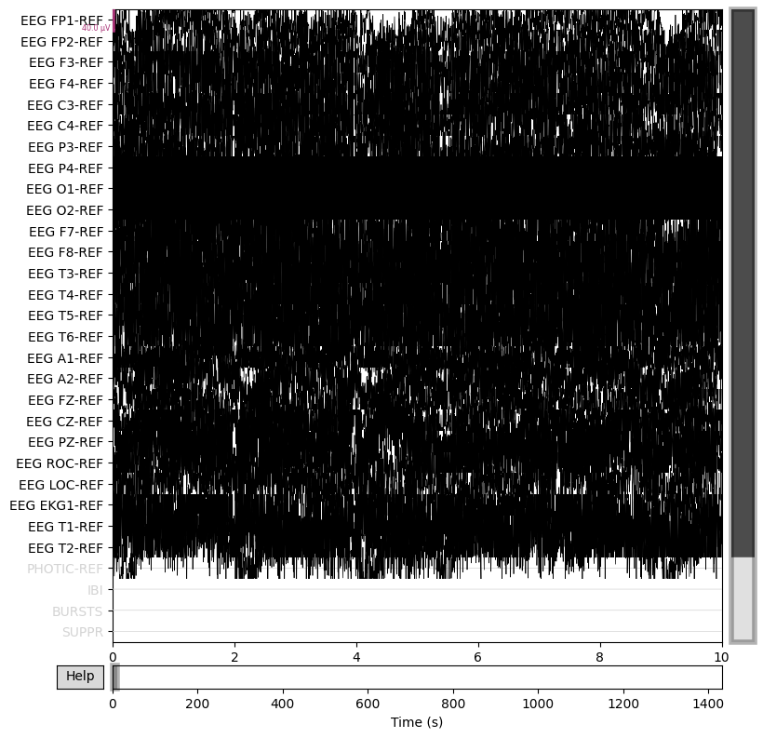
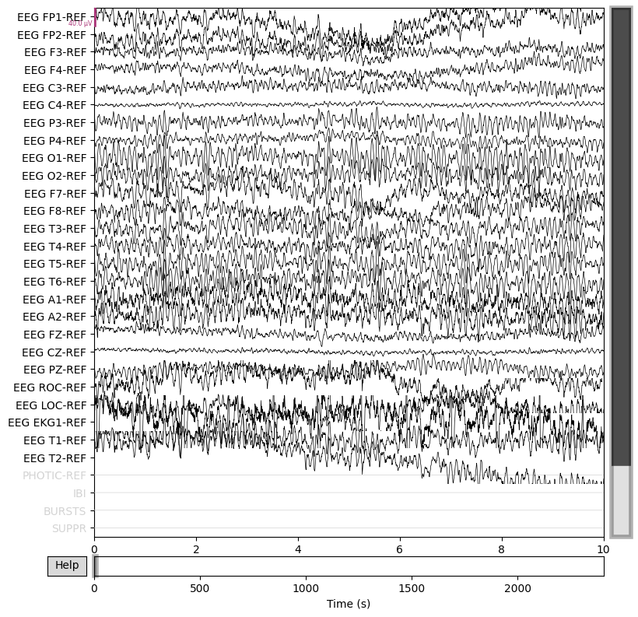
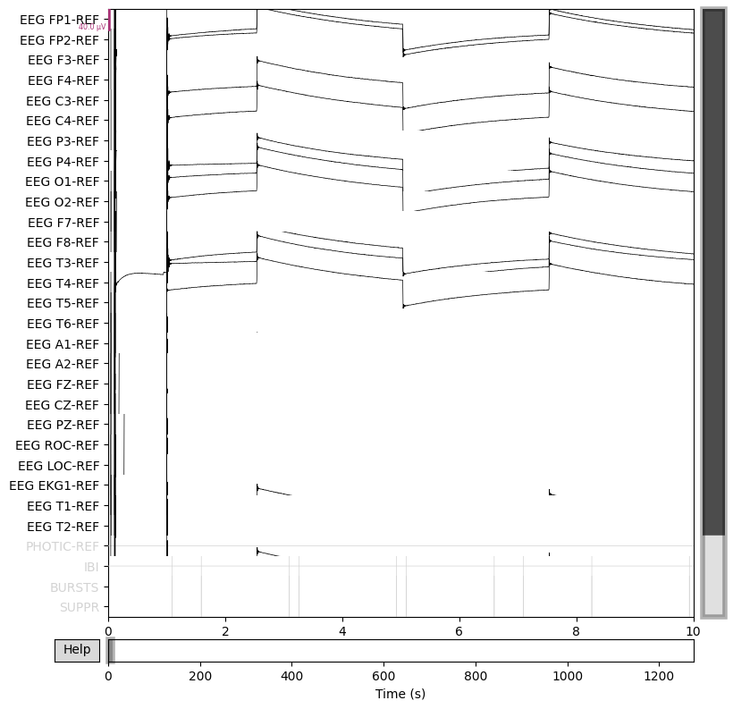
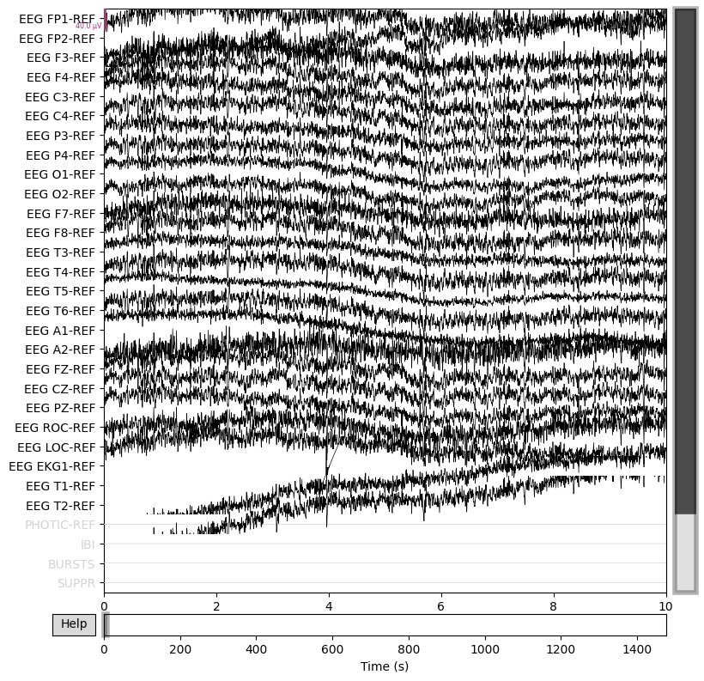
Crop

